Slide 1


Noida Institute of Engineering and Technology, Greater Noida
Introduction
Unit: I
Subject Name: Design Thinking II
Ms. Anuradha Singh
Assistant Professor
Department of CSE
Course Details: MTech Int 5th Sem

Slide 2
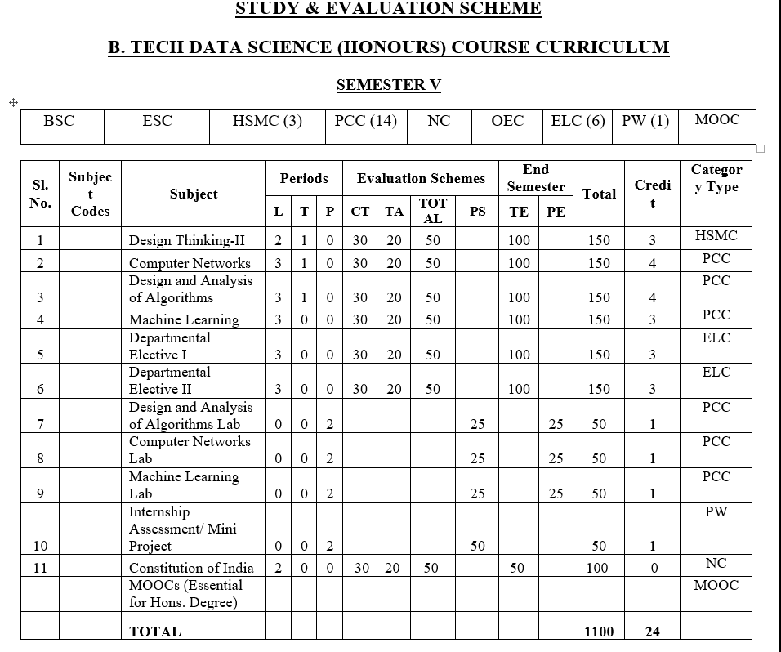
Evaluation Scheme

Slide 3

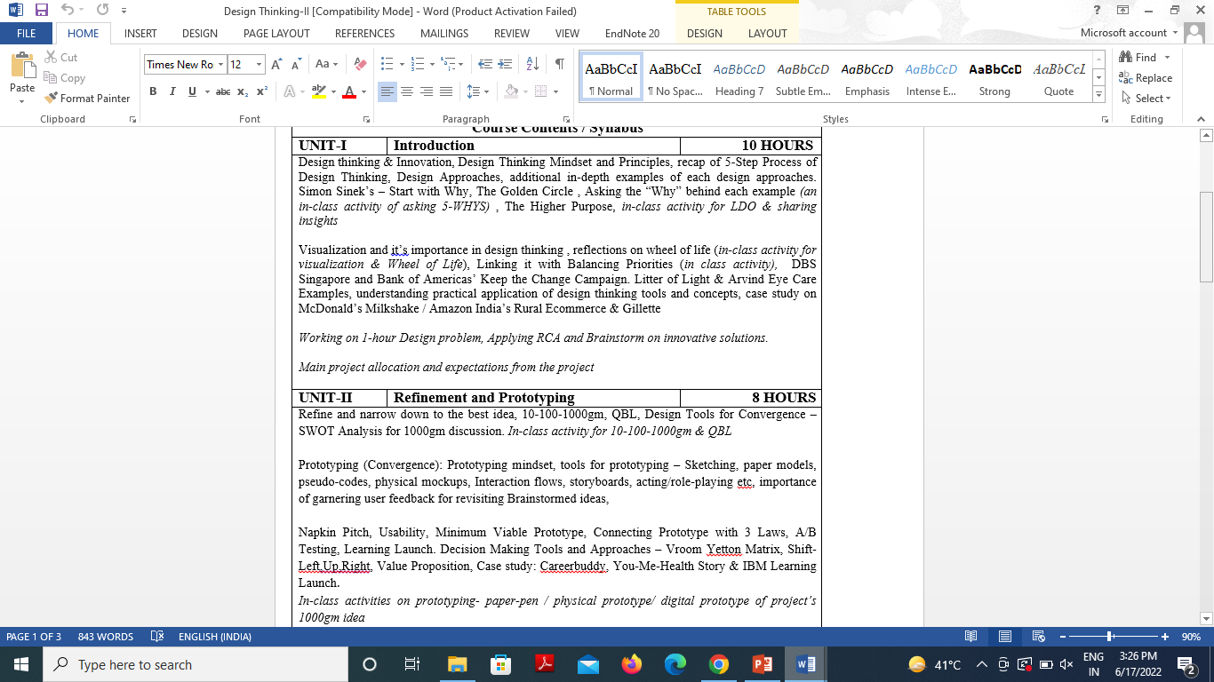
Syllabus

Slide 4

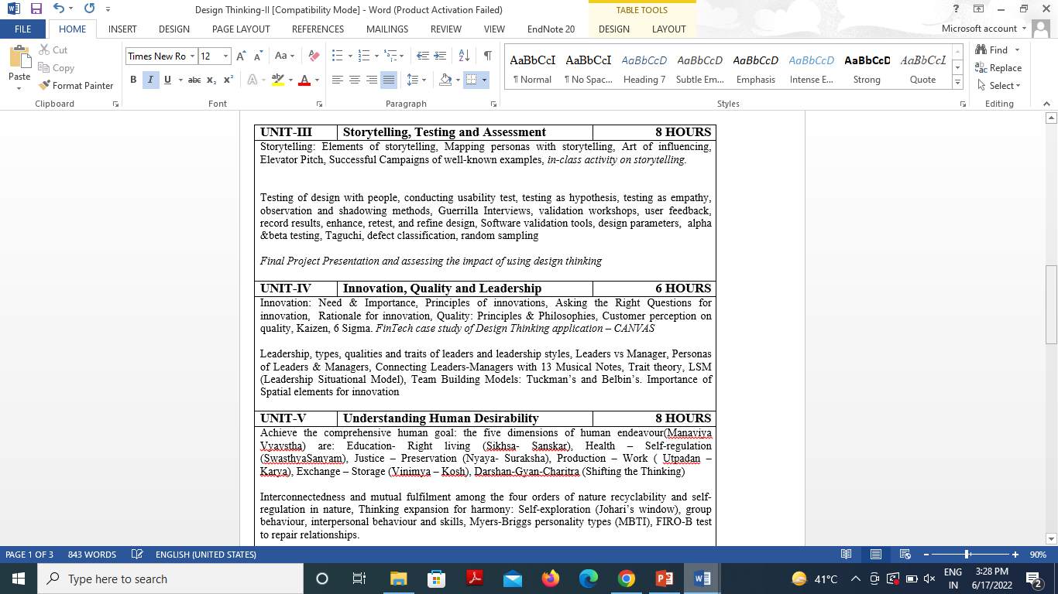
Syllabus

Slide 5
Content
Design thinking & Innovation
Design Thinking Mindset and Principles
Recap of 5-Step Process of Design Thinking
Design Approaches, additional in-depth examples of each design approaches
Simon Sinek’s – Start with Why
The Golden Circle
Asking the “Why” behind each example (an in-class activity of asking 5-WHYS)
The Higher Purpose
in-class activity for LDO & sharing insights
Visualization and it’s importance in design thinking, reflections on wheel of life (in-class activity for visualization & Wheel of Life)
Linking it with Balancing Priorities (in class activity)
DBS Singapore and Bank of Americas’ Keep the Change Campaign.
Litter of Light & Arvind Eye Care Examples
understanding practical application of design thinking tools and concepts
case study on McDonald’s Milkshake / Amazon India’s Rural Ecommerce & Gillette
working on 1- hour Design problem
Applying RCA and Brainstorm on innovative solutions.
Main project allocation and expectations from the project

Slide 6
Course Objective
The objective of this course is to upgrade Design Thinking skills by learning & applying advanced and contextual Design Thinking Tools.
It aims to solve a Real-Life Problem by applying Design Thinking to create an impact for all the stakeholders

Slide 7
Course Outcome
At the end of the semester, the student will be able:
 | Description | Bloom’s Taxonomy
CO1 | Learn sophisticated design tools to sharpen their problem-solving skills | K2
CO2 | Generate innovate ideas using design thinking tools and converge to feasible idea for breakthrough solution | K3,K4
CO3 | Implement storytelling for persuasive articulation | K3
CO4 | Understanding the nature of leadership empowerment | K2
CO5 | Understand the role of a human being in ensuring harmony in society and nature. | K2

Slide 8

Program Outcome
At the end of the semester, the student will be able:
POs | Engineering Graduates will be able to
PO1 | Engineering Knowledge
PO2 | Problem Analysis
PO3 | Design & Development of solutions
PO4 | Conduct Investigation of complex problems
PO5 | Modern Tool Usage
PO6 | The Engineer and Society
PO7 | Environment and sustainability
PO8 | Ethics
PO9 | Individual & Team work
PO10 | Communication
PO11 | Project management and Finance
PO12 | Life Long Learning

Slide 9
Program Specific Outcomes
S.NO. | Program Specific Outcomes | PSO Description
1 | PSO1 | The ability to identify, analyze real world problems and design their ethical solutions using artificial intelligence, robotics, virtual/augmented reality, data analytics, block chain technology, and cloud computing.
2 | PSO2 | The ability to design and develop the hardware sensor devices and related interfacing software systems for solving complex engineering problems.
3 | PSO3 | The ability to understand inter-disciplinary computing techniques and to apply them in the design of advanced computing.
4 | PSO4 | The ability to conduct investigation of complex problems with the help of technical, managerial, leadership qualities, and modern engineering tools provided by industry-sponsored laboratories.

Slide 10
CO-PO Mapping
Design Thinking
CO.K | PO1 | PO2 | PO3 | PO4 | PO5 | PO6 | PO7 | PO8 | PO9 | PO10 | PO11 | PO12
ACSE0503.1 | 3 | 3 | 3 | 3 | 2 | - | - | - | 2 | 2 | - | 3
ACSE0503.2 | 3 | 3 | 3 | 3 | 2 | 2 | - | 1 | 1 | 1 | - | 3
ACSE0503.3 | 3 | 3 | 2 | 3 | 3 | 2 | - | 2 | 1 | 1 | 2 | 3
ACSE0503.4 | 3 | 3 | 3 | 3 | 2 | 2 | - | 2 | 2 | 1 | 3 | 3
ACSE0503.5 | 2 | 2 | 2 | 2 | 2 | 2 | - | 2 | 1 | 1 | 1 | 2
Average | 2.8 | 2.8 | 2.6 | 2.8 | 2.2 | 1.6 | - | 1.8 | 1.4 | 1.2 | 1.2 | 2.8

Slide 11
CO-PSO Mapping
 | PSO1 | PSO2 | PSO3 | PSO4
ACSE0503.1 | 3 | 2 | 2 | -
ACSE0503.2 | 3 | 3 | 2 | -
ACSE0503.3 | 3 | 3 | 3 | -
ACSE0503.4 | 3 | 3 | 2 | -
ACSE0503.5 | 3 | 3 | 2 | -
Average | 3 | 2.8 | 2.2 | -

Slide 12
Program Educational Objectives (PEOs)
Program Educational Objectives (PEOs) | PEOs Description
PEOs | To have an excellent scientific and engineering breadth to comprehend, analyze, design and provide sustainable solutions for real-life problems using state-of-the-art technologies.
PEOs | To have a successful career in industries, to pursue higher studies or to support entrepreneurial endeavors and to face global challenges.
PEOs | To have an effective communication skill, professional attitude, ethical values and a desire to learn specific knowledge in emerging trends, technologies for research, innovation and product development and contribution to society.
PEOs | To have life-long learning for up-skilling and re-skilling for successful professional career as engineer, scientist, entrepreneur, and bureaucrat for betterment of society.

Slide 13
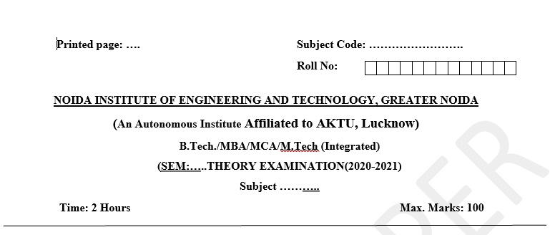
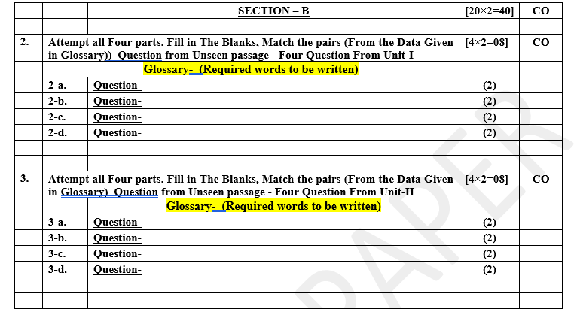
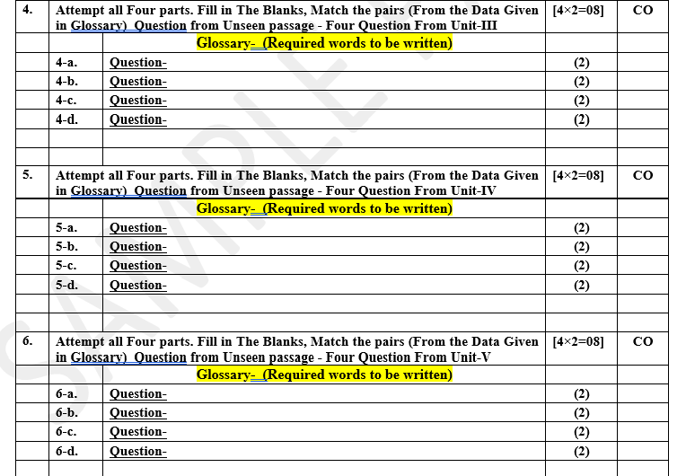
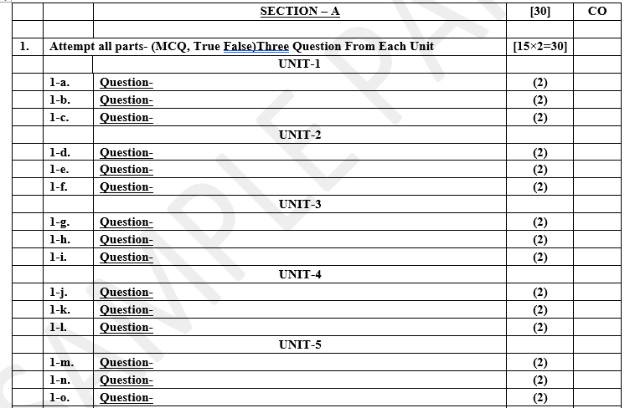
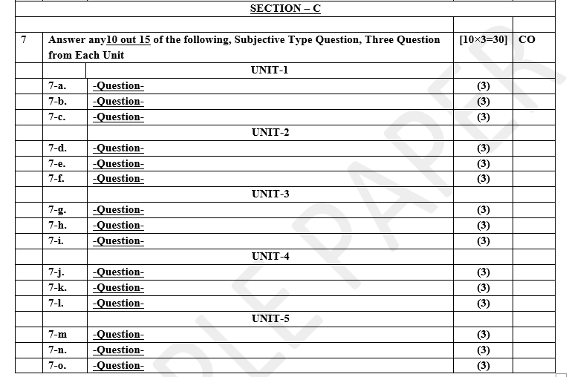
Pattern of Online External Exam Question Paper (100 marks)

Slide 14
Prerequisite and Recap
Pre-requisites: Student must complete Design Thinking-I course

Slide 15
Brief Introduction about the subject with videos
Design Thinking is not an exclusive property of designers — all great innovators in literature, art, music, science, engineering, and business have practiced it. So, why call it Design Thinking? What’s special about Design Thinking is that designers’ work processes can help us systematically extract, teach, learn and apply these human-centered techniques to solve problems in a creative and innovative way — in our designs, in our businesses, in our countries, in our lives.​
https://careerfoundry.com/en/blog/ux-design/what-is-design-thinking-everything-you-need-to-know-to-get-started/
https://www.youtube.com/watch?v=-ySx-S5FcCI ​

Slide 16
Program Educational Objectives (PEOs)
Program Educational Objectives (PEOs) | PEOs Description
PEOs | To have an excellent scientific and engineering breadth so as to comprehend, analyze, design and provide sustainable solutions for real-life problems using state-of-the-art technologies.
PEOs | To have a successful career in industries, to pursue higher studies or to support entrepreneurial endeavors and to face the global challenges.
PEOs | To have an effective communication skills, professional attitude, ethical values and a desire to learn specific knowledge in emerging trends, technologies for research, innovation and product development and contribution to society.
PEOs | To have life-long learning for up-skilling and re-skilling for successful professional career as engineer, scientist, entrepreneur and bureaucrat for betterment of society.

Slide 17
Prerequisite and Recap
Pre-requisites: Student must complete Design Thinking-I course
Recap:
Million Dollar Idea
Empathy maps
Mind-Map
CATWOE Analysis

Slide 18
Unit Objective
.
To get detailed insights of design thinking approaches, tools related to it and balancing the priorities.

Slide 19
Topic Objective
Design thinking & Innovation, Design Thinking Mindset and Principles, recap of 5-Step Process of Design Thinking, Design Approaches, additional in-depth examples of each design approaches. Simon Sinek’s – Start with Why, The Golden Circle, Asking the “Why” behind each example (an in-class activity of asking 5-WHYS), | To learn different types of design approaches
The Higher Purpose, in-class activity for LDO & sharing insights, Visualization and it’s importance in design thinking, reflections on wheel of life (in-class activity for visualization & Wheel of Life) | To learn different types of tools
Linking it with Balancing Priorities (in class activity), DBS Singapore and Bank of Americas’ Keep the Change Campaign. Litter of Light & Arvind Eye Care Examples, understanding practical application of design thinking tools and concepts, case study on McDonald’s Milkshake / Amazon India’s Rural Ecommerce & Gillette, working on 1- hour Design problem, Applying RCA and Brainstorm on innovative solutions. Main project allocation and expectations from the project | To understand decision making tools

Slide 20
Recap: Million Dollar Idea Tool (CO1)

Slide 21
Recap: Empathy Map (CO1)
A simple, easy-to-digest visual that captures knowledge about a user’s behaviors and attitudes.
Helps designers see things from the user’s perspective.
An active ingredient during Listening, Dialogue, Observation
Used right from the outset of the Design Thinking Process to help the Design Thinker develop empathy, understanding, experiences, insights and observations.
But...
It is an iterative tool. Users can go back to the map and refine it as and when they notice something new during a dialogue or interaction with the user.

Slide 22
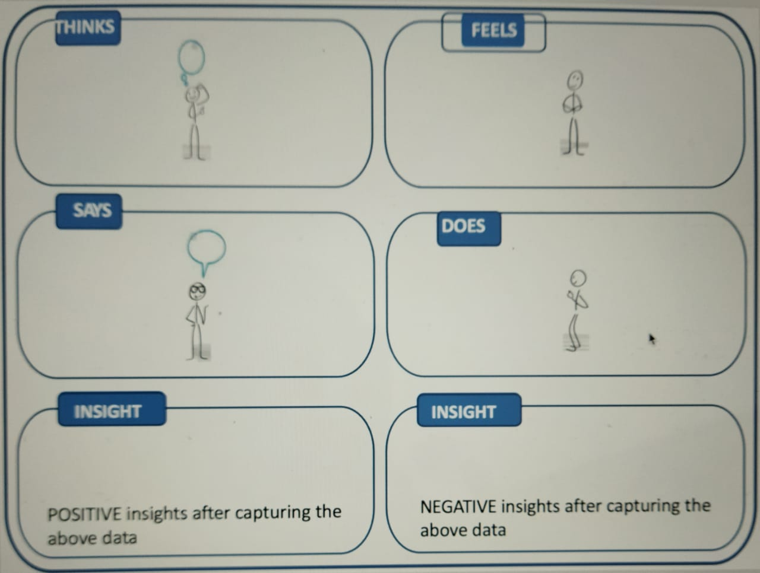
Recap: Empathy Map Cont…(CO1)

Slide 23
Recap: Mindmap
Great tool for ideating & getting unstuck.
Simple free association of words, one after another, to open up idea space.
Being visual, generates lots of ideas by bypassing the inner logic / verbal sensor.
Tool to represent how ideas are linked to each other and to the central idea.
Used to generate, visualize, structure and classify items.
Helps to look for patterns & insights.
Displays data, clusters them and helps themes & patterns to emerge Provides decision criteria.
Success lies in being a team activity.
Taps into the power of visualization.

Slide 24
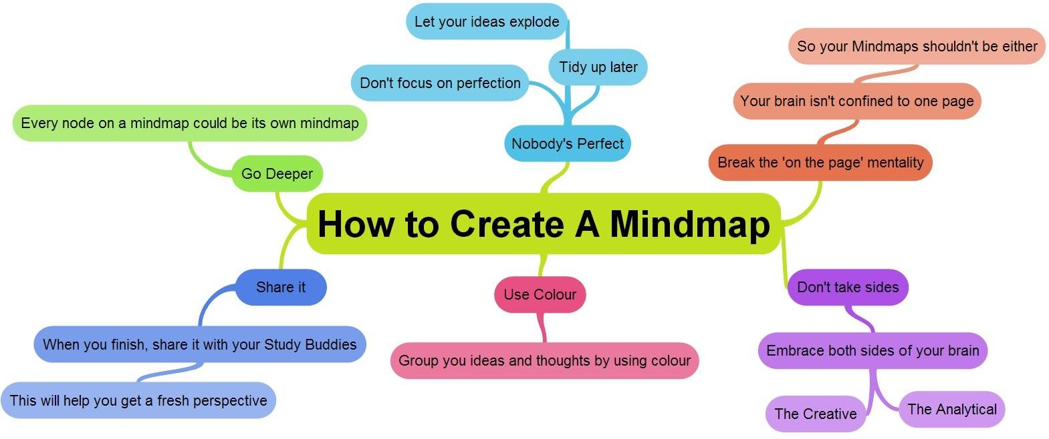
Recap: Mindmap Cont... (CO1)

Slide 25
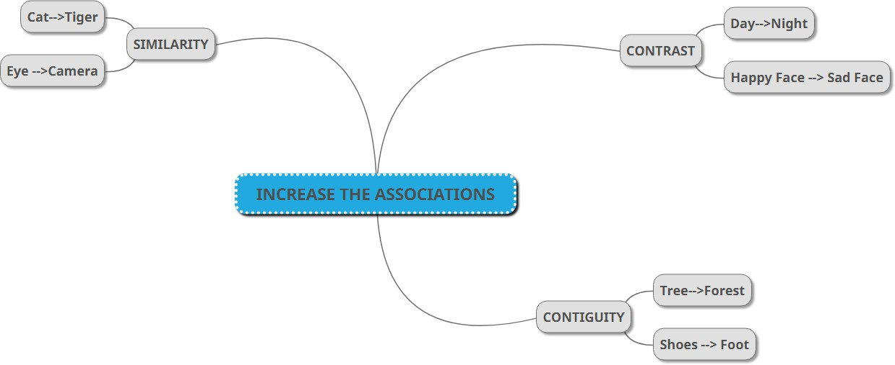
Recap: Mindmap Example (CO1)

Slide 26
Recap: CATWOE Analysis (CO1)
CATWOE Analysis technique was considered as one of the important part of SSM approach while identifying stakeholders in solving problems.
Enlists all the stakeholders who would be affected while solving problems & understand their perspective
Helps to avoid the personal bias/beliefs of problem solvers as they critically discuss each element of CATWOE
Unearths the bigger picture with regards to constraints, challenges, possible outcomes and their effects on the stakeholder(s)
Understand the conflicts between stakeholders, their roles, conflicts in roles & possible actions (they might take) during the process of problem solving

Slide 27
Recap: CATWOE uses (CO1)
To solve any complex problem where multiple stakeholders are involved.
To change an existing system impacting a variety of people.
To enable Change Management for better adoption of change by stakeholders.
Used in typical Project Management.
To launch a concept that will radically change the existing system.

Slide 28
Recap: Elements of CATWOE (CO1)
The ‘CAT’
Customers
Those who face the current problem for whom you will be working on the solution.
Those who will be using your solution
Those directly affected by your idea
Actors
Those who actually implement the solution/transformation
Transformation
Does not involve writing any stakeholder; but write in clear-cut terms about the Why, What, How of the problem and the solution/transformation you wish to bring to solve
By clearly thinking and writing, you will think of stakeholders who can be classified in other elements

Slide 29
Recap: Elements of CATWOE (CO1)
The ‘WOE’
Worldview
Very important during analysis when thinking beyond the system
Considering stakeholders beyond current system who will be affected indirectly by solution/transformation
Think of the bigger picture (beyond the system)
Owners
Stakeholders who own the permission to start/stop/pause/cancel your transformation / solution
Leaders who have the ability to guide the solution as well as block it
Environment Constraints
Constraints (legal, political, ethical, regulation, norms, financial, human power, etc.) or rules that may hinder solution implementation

Slide 30

Design Thinking Introduction(CO1)
Design is a process of working to develop solutions in a conscious and innovative way in which both functional and aesthetic requirements are included based on user needs.
Human Centered
Future Focused
Creates Value

Slide 31
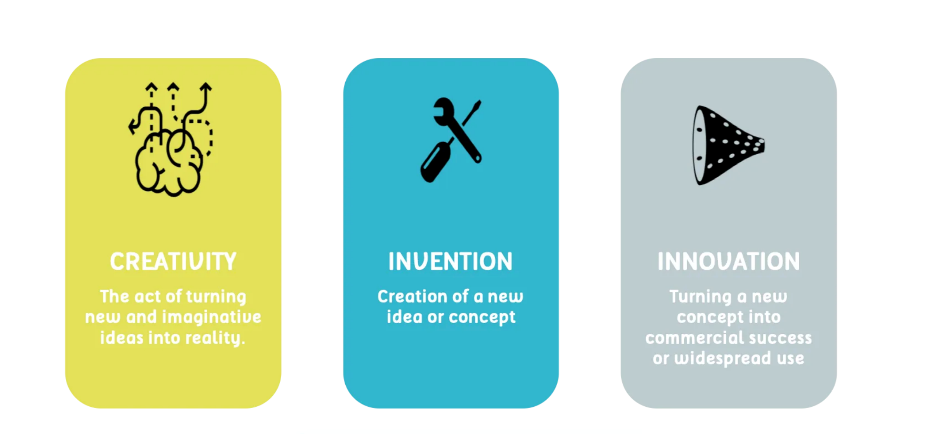
Innovation and Creativity(CO1)

Slide 32
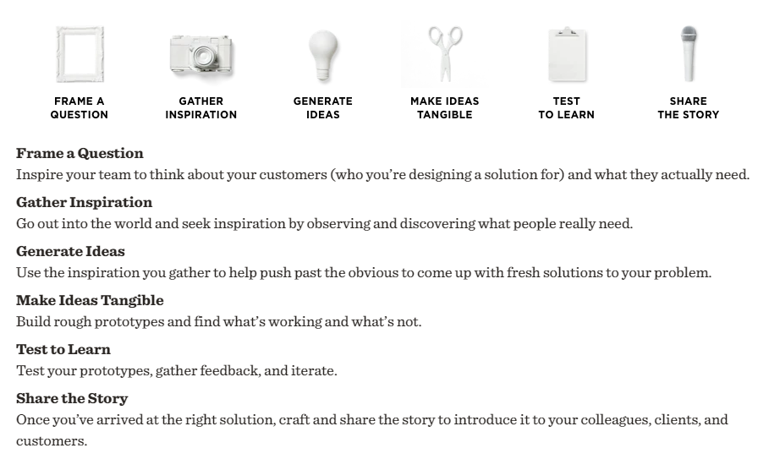
Design Mindset (CO1)

Slide 33
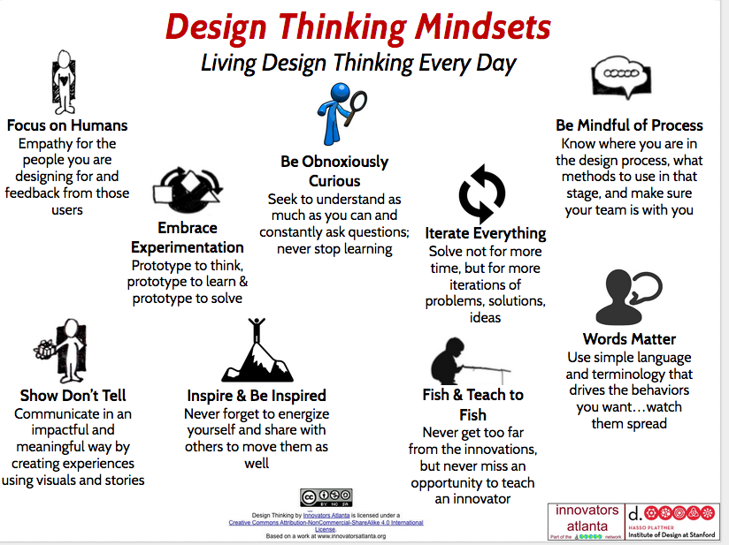
Design Thinking Mindset(CO1)

Slide 34

3 Core Design Thinking Principles(CO1)

Slide 35
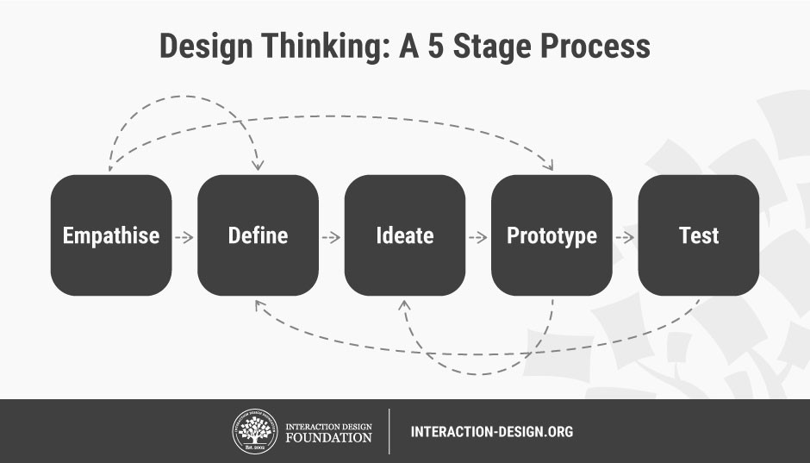
Design Thinking model :
Hasso-Plattner Institute of Design at Stanford

Slide 36
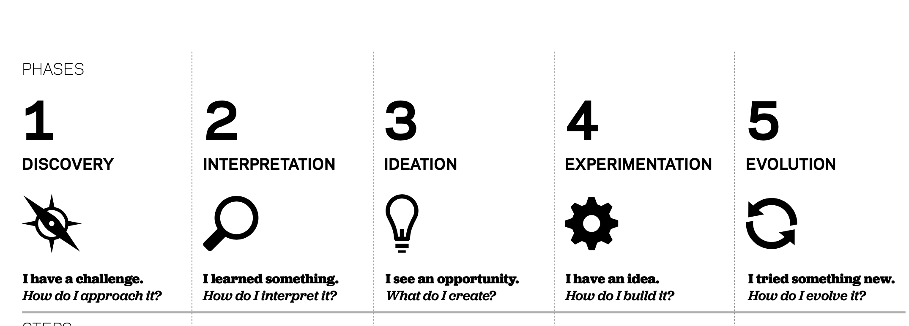
Design Thinking Model: IDEO (CO1)

Slide 37
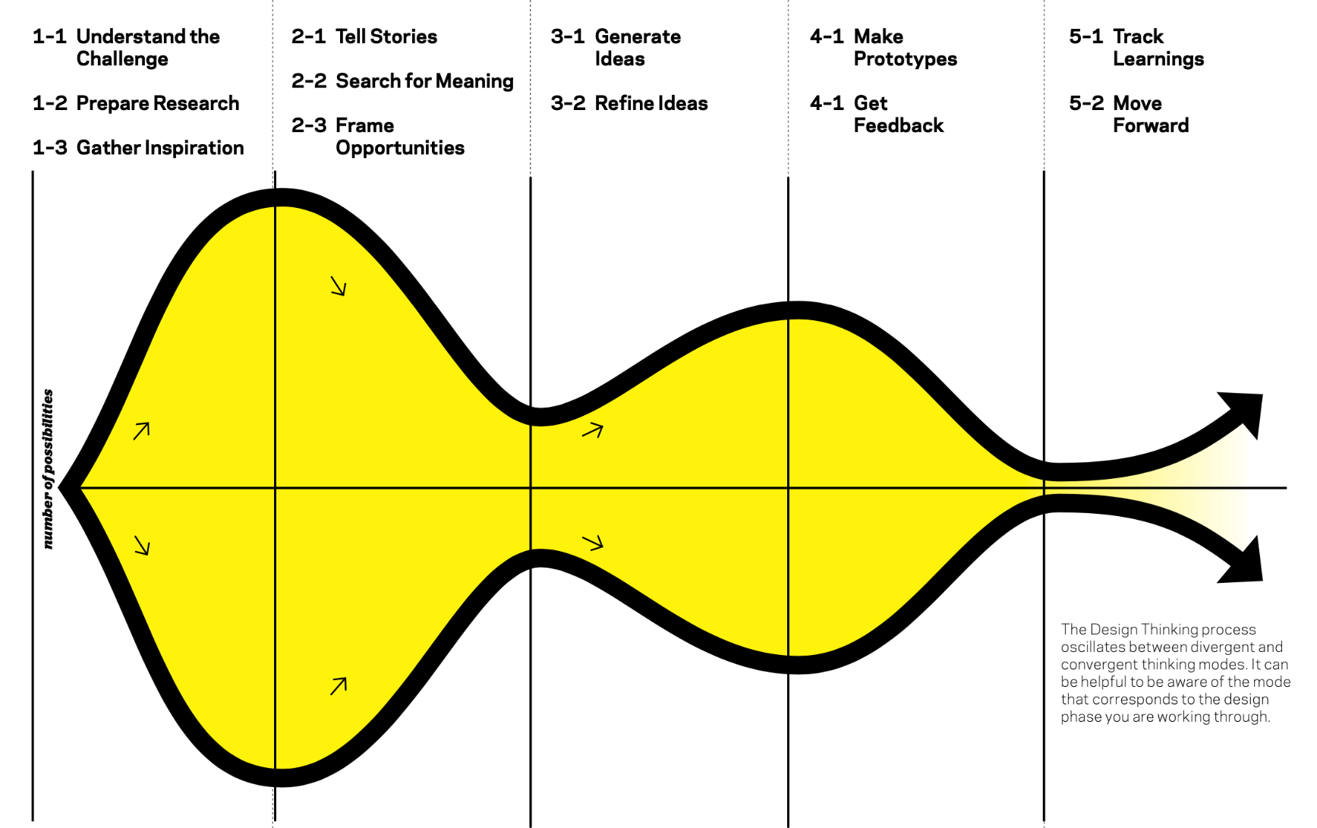
Design Thinking Model: IDEO (CO1) Cont….

Slide 38
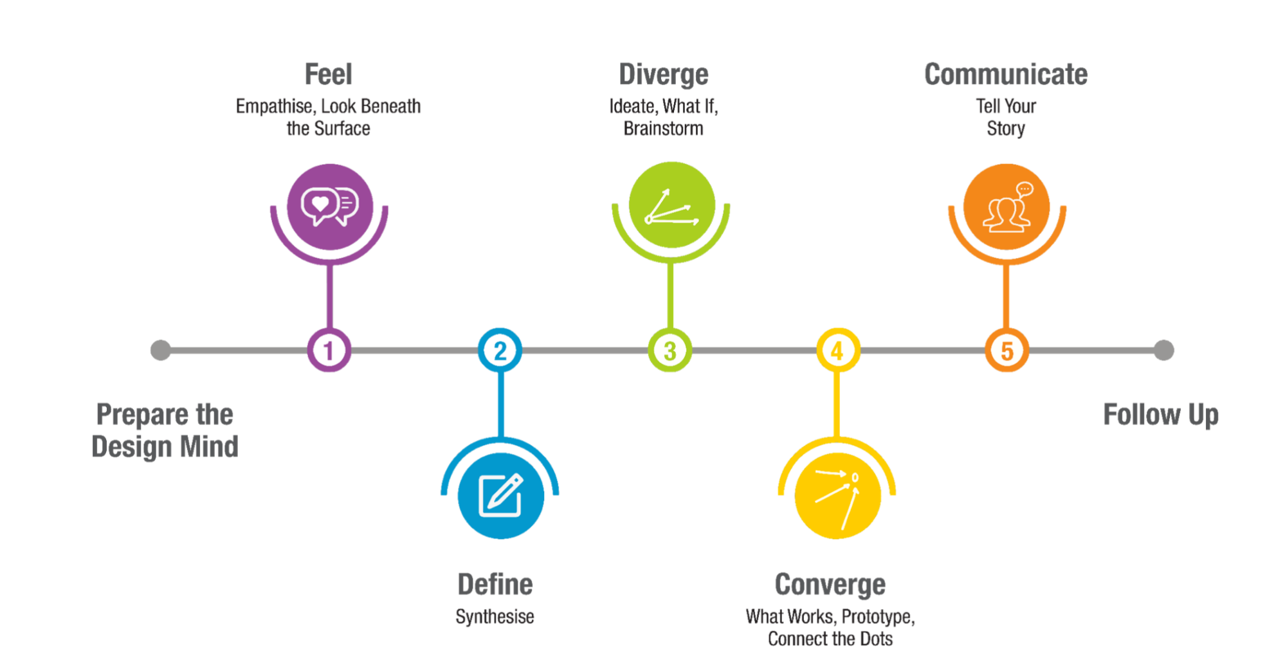
Design Thinking Process: School of Design Thinking(CO1)

Slide 39
Daily Quiz
Design is a process of working to develop solutions in a conscious and innovative way in which both _____and ______ requirements are included based on user needs.
functional and aesthetic
Customer and seller
Weak and strong
Good or Bad
Design Thinking typically helps in _______
Innovation
Creativity
Dialogue
Observation

Slide 40
Daily Quiz
Design thinking is often also called________
Human Centred design
Ecological sustainability
Alien diversity
Intellectual property
What is Innovation?
The process of turning a new concept into commercial success or widespread use.
The creation of a new idea or concept.
The act of turning new and imaginative ideas into reality.
None of the above

Slide 41
Simon Sinek’s – Start with Why (CO1)
Start with Why shows that the leaders who’ve had the greatest influence in the world all think, act, and communicate the same way—and it’s the opposite of what everyone else does. Sinek calls this powerful idea The Golden Circle, and it provides a framework upon which organizations can be built, movements can be led, and people can be inspired. And it all starts with WHY.
https://www.ted.com/talks/simon_sinek_how_great_leaders_inspire_action?language=en

Slide 42
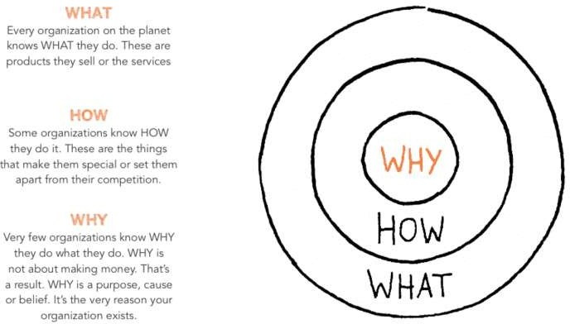
The Golden Circle (CO1)

Slide 43
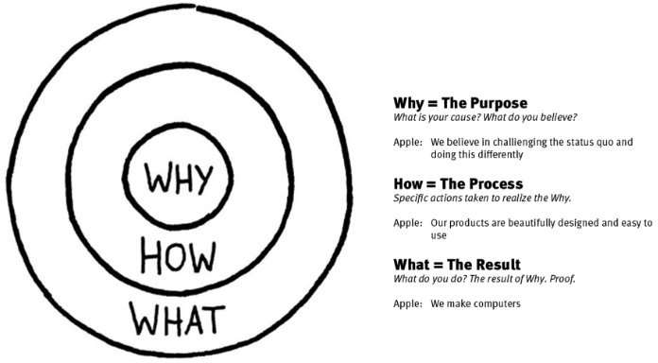
Simon Sinek – The Golden Circle (CO1)

Slide 44
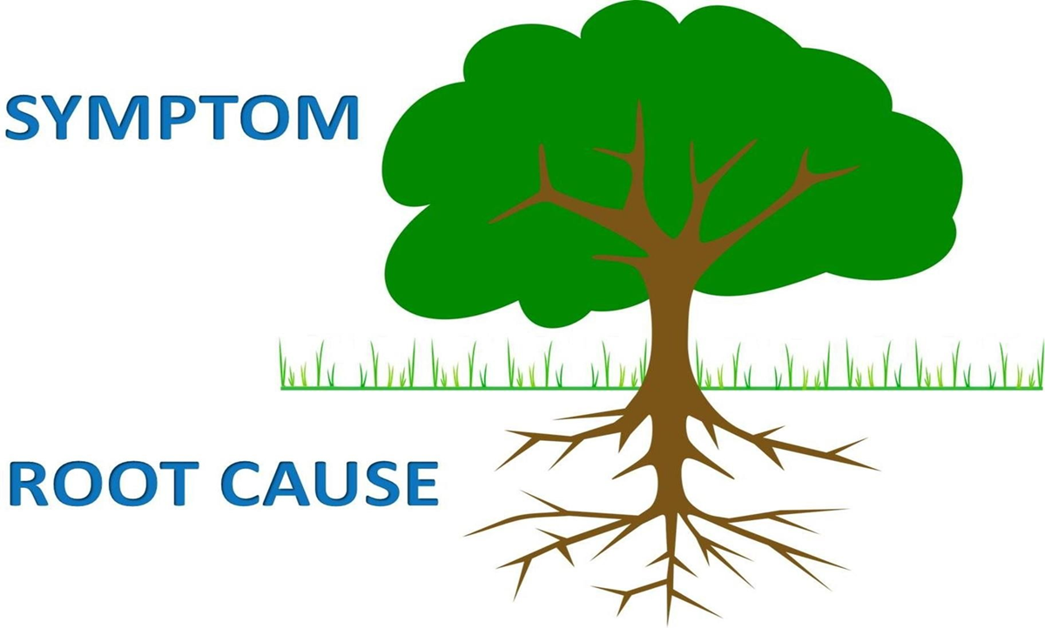
Asking the “Why” behind each example (5-WHYS)
(CO1)

Slide 45

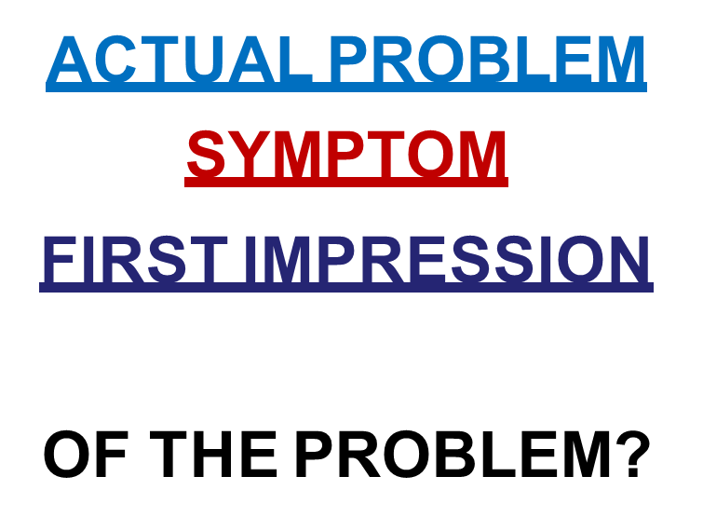
Asking the “Why” behind each example Cont…(5-WHYS)
(CO1)

Slide 46
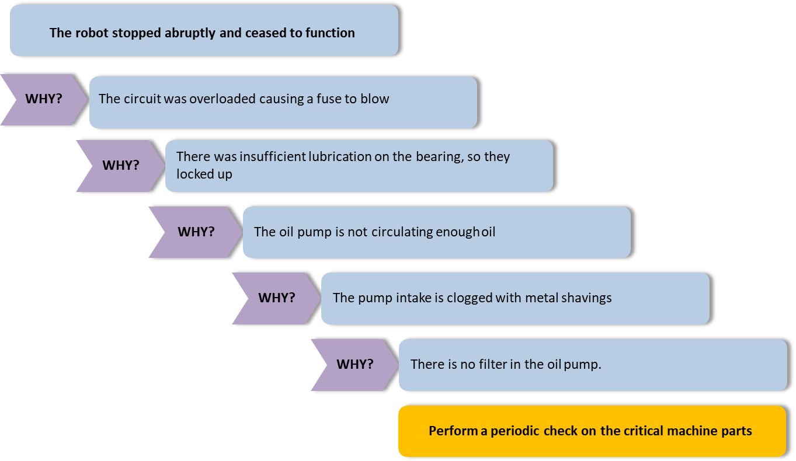
5-WHYS example (CO1)

Slide 47
Weekly Assignment
Explain Design thinking & Innovation.
Summarize Design Thinking Mindset and Principles.
Discuss 5-Step Process of Design Thinking.
Briefly describe Design Approaches.
Illustrate examples of each design approaches.
Describe Simon Sinek’s – Start with Why
Analyze ”The Golden Circle”.

Slide 48
Weekly Assignment
Explain Design thinking & Innovation.
Summarize Design Thinking Mindset and Principles.
Discuss 5-Step Process of Design Thinking.
Briefly describe Design Approaches.
Illustrate examples of each design approaches.
Describe Simon Sinek’s – Start with Why
Analyze ”The Golden Circle”.

Slide 49
Weekly Assignment
Explain Design thinking & Innovation.
Summarize Design Thinking Mindset and Principles.
Discuss 5-Step Process of Design Thinking.
Briefly describe Design Approaches.
Illustrate examples of each design approaches.
Describe Simon Sinek’s – Start with Why
Analyze ”The Golden Circle”.

Slide 50
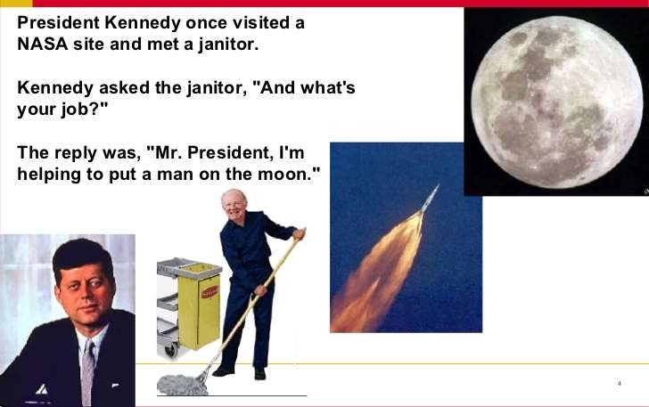
The Higher Purpose (CO1)

Slide 51
Class Activity (CO1)
LDO & sharing insights
Notes:
Listening
Dialogue
Observation

Slide 52

Class Activity (CO1)
Notes:
Listening
Dialogue
Observation

Slide 53
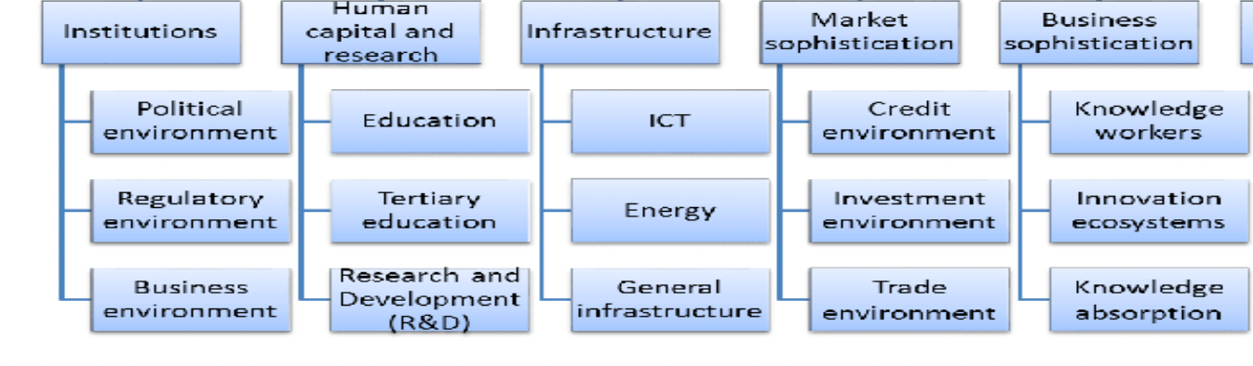
LD0 Framework Example for Innovation Input Index(CO1)

Slide 54
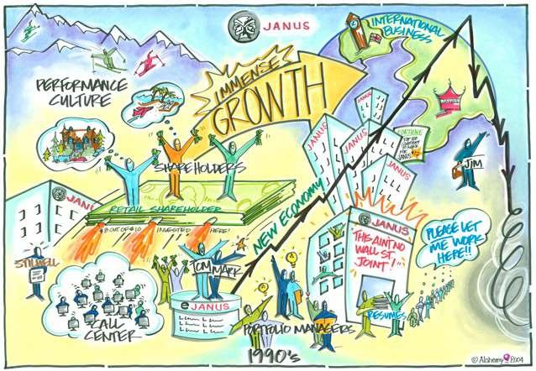
VISUALIZATION - Dream after 5 / 10 years….. (CO1)

Slide 55
Visualization (CO1)
Visualization is about using images. It’s not about drawing; it’s about visual thinking. It pushes us beyond using words or language alone. It is a way of unlocking a different part of our brains that allows us to think nonverbally and that managers might not normally use.

Slide 56
Visualisation importance in design thinking (CO1)
Understand the problem
Idea generation
Build and test solutions

Slide 57
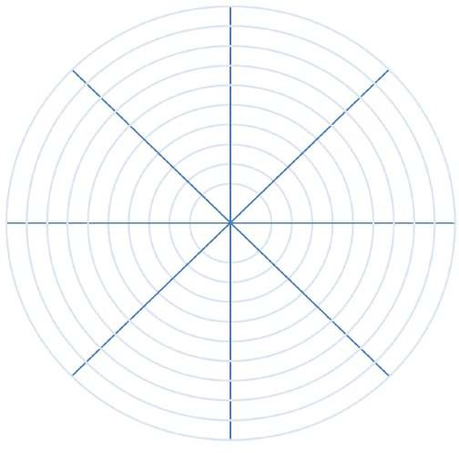
WHEEL OF LIFE – How much time are we devoting to priorities? (CO1)
Learning
Fitness
Career
Family
Week 1
Week 2
0 – 10 rating

Slide 58
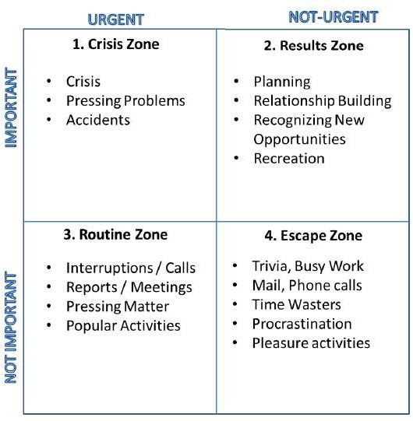
BALANCING PRIORITIES – 4 Quadrants of Stephen Covey (CO1)

Slide 59
Daily Quiz
The golden circle has three layers______, _____ & ______ .
Why, how and what
More, much and less
Good, Bad and worst
There, here and where
________ is a core component of the way that we communicate, whether we're aware of it or not.
Visualisation
Dialogue
Observation
Empathy

Slide 60
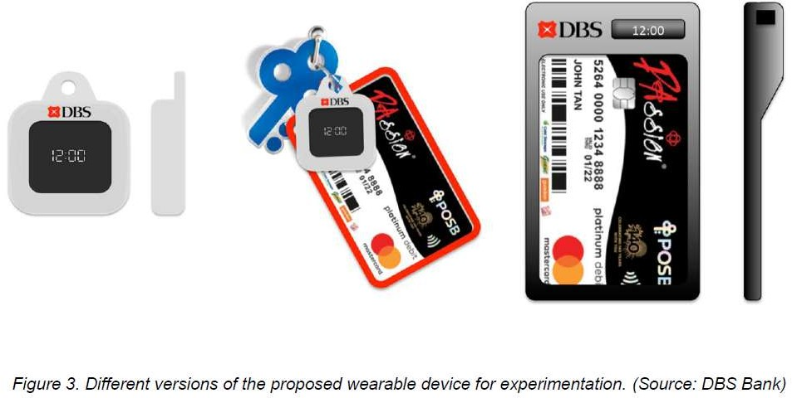
DBS SINGAPORE – Banking for the Elders (CO1)

Slide 61
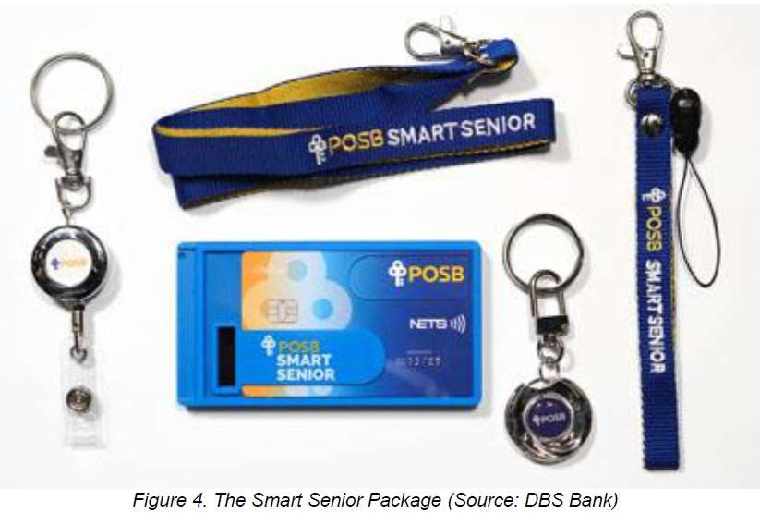
DBS SINGAPORE – Banking for the Elders (CO1)

Slide 62
DBS SINGAPORE – Banking for the Elders (CO1)
Case Study Document: https://issuu.com/kidhnt95/docs/dbs_case_study

Slide 63
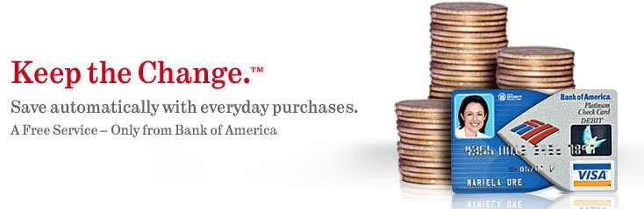
KEEP THE CHANGE – Bank Of America (CO1)

Slide 64
KEEP THE CHANGE – Bank Of America (CO1)
Case Study Document:
https://thisisdesignthinking.net/2018/09/feeling-in-control-bank-of-america-helps-customers-to-keep-the-change/

Slide 65
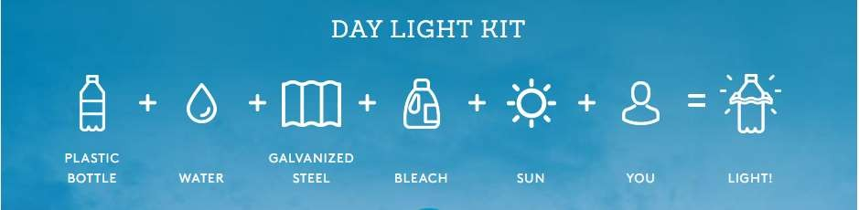

LITER OF LIGHT – Low Cost Power of Light (CO1)

Slide 66
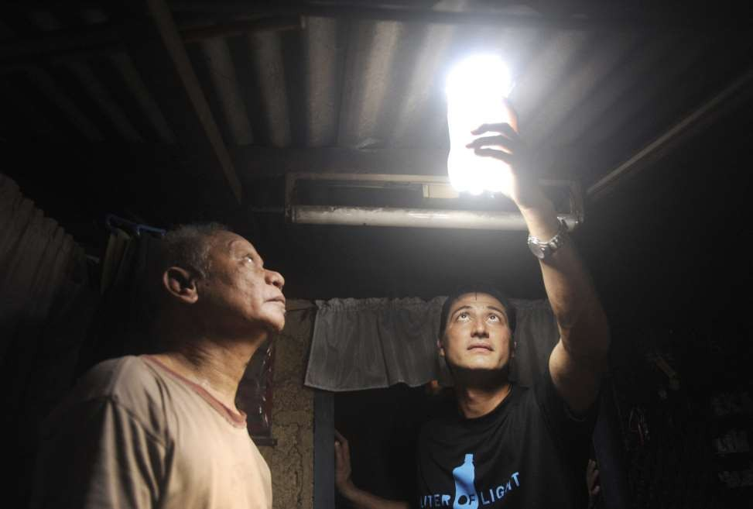

LITER OF LIGHT – Low Cost Power of Light (CO1)

Slide 67
LITER OF LIGHT – Low Cost Power of Light (CO1)
https://www.youtube.com/watch?v=o-Fpsw_yYPg

Slide 68

ARAVIND EYE CARE – Affordable & Efficient (CO1)

Slide 69
ARAVIND EYE CARE – Affordable & Efficient (CO1)
Reference Document:
https://medium.com/@nayanthakare007/aravind-eye-hospitals-innovating-eye-care-through-design-thinking-2e6b137898e2
https://www.youtube.com/watch?v=3cjnNPua7Ag

Slide 70
Daily Quiz
“The problem of avoidable blindness rapidly escalating remained a major cause of concern in the Indian healthcare scenario”. This statement belongs to _______ .
Aravind Eye Care
Fortis
AIIMS
Escort
__________first initiative failed to produce more sales because they didn’t ask their customers the right questions.
McDonalds’
Dominos
KFC
Pizza Hut

Slide 71
Weekly Assignment
Discuss the “Why” behind each example (5-WHYS).
Describe the Higher Purpose.
Explain Visualization and it’s importance in design thinking.
Illustrate reflections on wheel of life (in-class activity for visualization & Wheel of Life).
How we can link reflection of wheels with Balancing Priorities.
Summarize DBS Singapore and Bank of Americas’ Keep the Change Campaign.
Discuss Litter of Light & Arvind Eye Care.

Slide 72
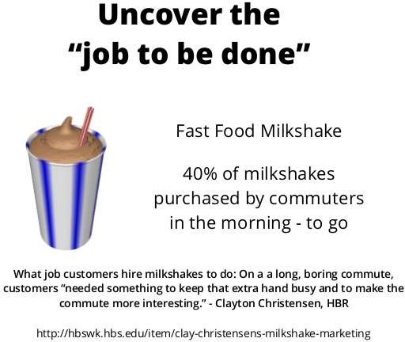
McDonald’s Milkshake – Job to be done theory (CO1)

Slide 73
McDonald’s Milkshake – Job to be done theory (CO1)
https://concurate.com/how-jtbd-job-to-be-done-theory-helped-mcdonalds/

Slide 74
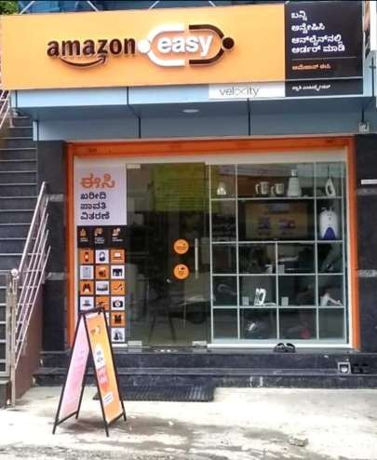
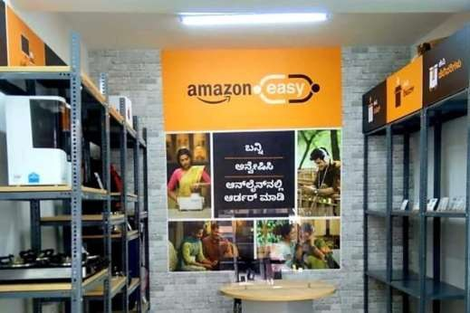
Amazon Easy Model E-Commerce for Rural India (CO1)

Slide 75
Amazon Easy Model E-Commerce for Rural India (CO1)
To hack into India’s 900 million+ rural population, Amazon has been opening physical stores in India. It's called the 'Amazon easy' model. A short case study.
Amazon faced 3 main issues in expanding into rural India:
1) The majority had never shopped online
2) Deliveries were a nightmare
3) In a highly cost-conscious society, trust had to be established
So this is what they did (in 3 steps)
STEP 1- Establish Trust
Amazon set up ‘Amazon easy' to help people shop online. These shops also gave Amazon a familiar physical presence
STEP 2- Educate
Amazon staff in these shops teach customers how to search for products, pick the right size, and help order it.
Interestingly, Amazon had to get educated too.
They realised,
1) People mistook the ‘search symbol’ for a table tennis bat. So they included pop-up hints in Hindi. The concept of ‘cart’ was also unknown. So Amazon changed ‘add to cart’ icon to a ‘bag’ icon.
2) Analysis showed- people left Amazon to search for videos of products before buying them. So Amazon included video descriptions on the product pages itself.

Slide 76
Amazon Easy Model E-Commerce for Rural India (CO1)
STEP 3- Simplify Deliveries
Extraordinarily, people can come to stores to pickup orders, actually try on clothes & only then pay.
Yet, deliveries had to be simplified. Vague landmarks like ‘behind the temple’ meant that local knowledge was essential.
So Amazon launched an ‘I have space’ program to partner with local store owners, who would both store as well as deliver goods in their localities.
Flipkart has a similar program. They work with 1.6 million shops or ‘kiranas’. Amazon just has 28,000 right now, but you bet they will scale fast.
This sector is so hot right now, that it even has a nickname - ‘Kirana tech’
We are curious to learn from you if there are other companies with smart innovations in rural India.

Slide 77

Gillette – Safety First (CO1)

Slide 78
Gillette – Safety First (CO1)
https://www.businesstoday.in/magazine/lbs-case-study/story/gillette-innovated-improved-its-market-share-in-india-47708-2014-04-04

Slide 79
Design Thinking Case Study – CareerBuddy(CO1)
Case Focuses on failures of application –
Did not prioritize experience for users
Didn’t prototype in iterative ways
Didn’t engage all stakeholders
Designed overly complex system

Slide 80
Design Thinking Case Study – Me You Health Story(CO1)
Case Focuses on
Development of an program (leveraging technology & social media) for healthier lifestyle.
Conducted Research for their target users (ethnographic research) – unstated needs
Importantly, they told users to visualize their well-being (after 5 years)
Health is emotional subject – Case focuses on how stimuli was given to participants to garner their ideas about their health
Arrived at 7 different personas depending on multiple factors
What appealed to one persona totally differed to what appealed to other persona
Gamification for Minimum Viable Prototype – Fail Fast Fail Quickly (making small incremental changes)
This helped to arrive at notification time-table, reminders for exercises, small tasks about fitness etc.
Platform uses technology, social feedback, app(s) etc for their users

Slide 81
Design Thinking Case Study – Me You Health Story(CO1)
https://slideplayer.com/slide/12940679/
https://www.youtube.com/watch?v=mXXg-DE5-Ws

Slide 82
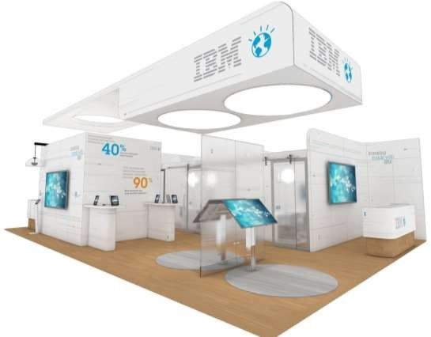
Design Thinking Case Study - IBM Learning Launch(CO1)

Slide 83
Design Thinking Case Study - IBM Learning Launch(CO1)
https://www.coursera.org/lecture/uva-darden-design-thinking-innovation/the-ibm-story-iq0kE

Slide 84

Writable Spaces – Transparent Glass (CO1)

Slide 85
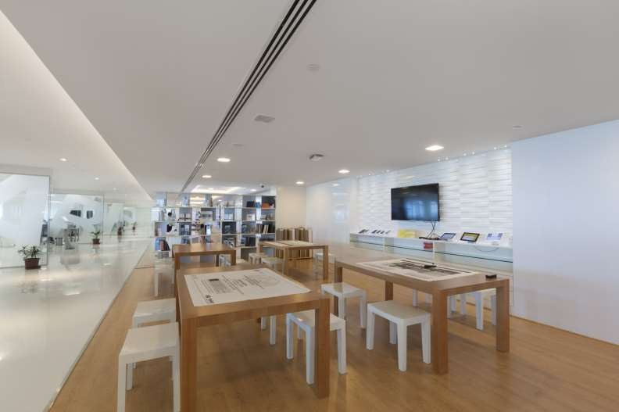
Writable Spaces – Writable Walls (CO1)

Slide 86
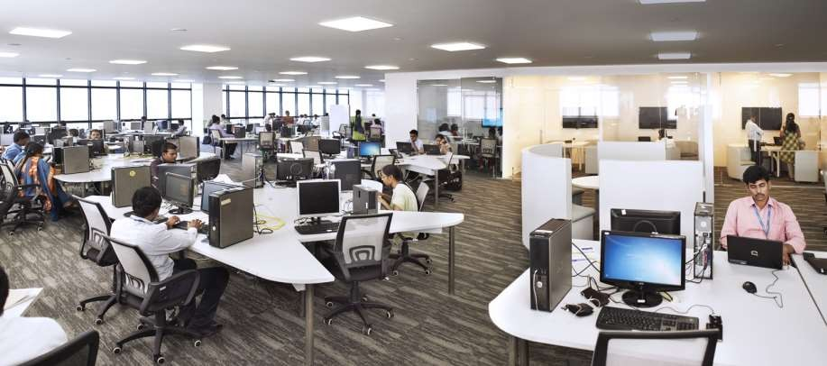
Collaborative Seating Arrangements (CO1)

Slide 87
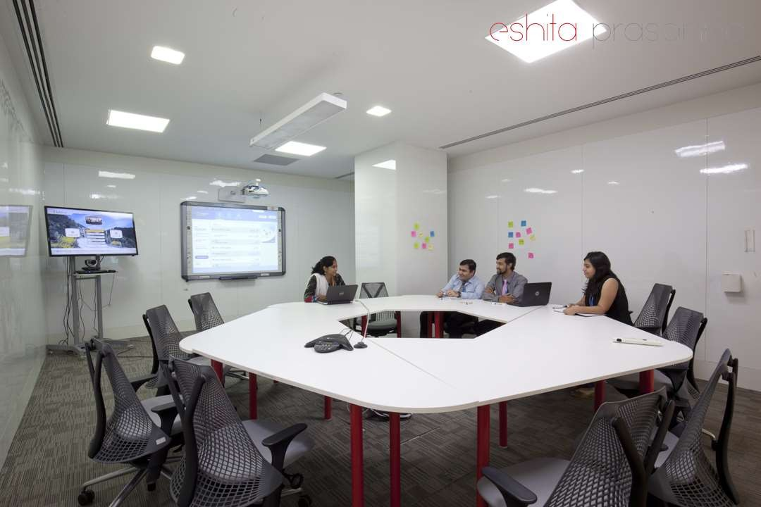
Collaborative Seating Arrangement (CO1)
Collaborative Seating Arrangement

Slide 88

Connecting the dots – Different screens to present effectively(CO1)

Slide 89
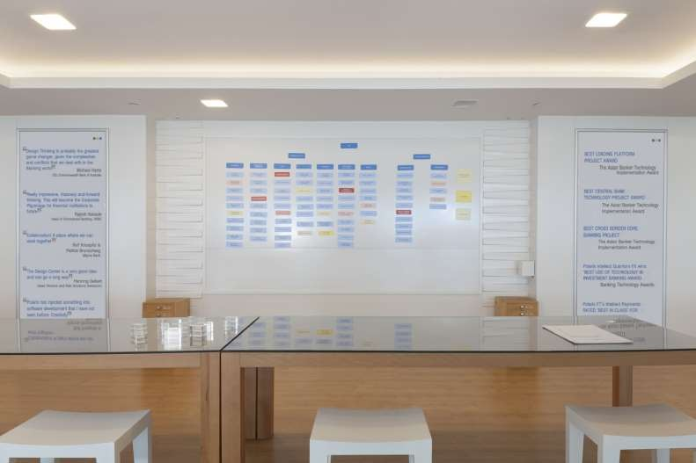
Collaborative discussions through Magnetic Wall (CO1)

Slide 90
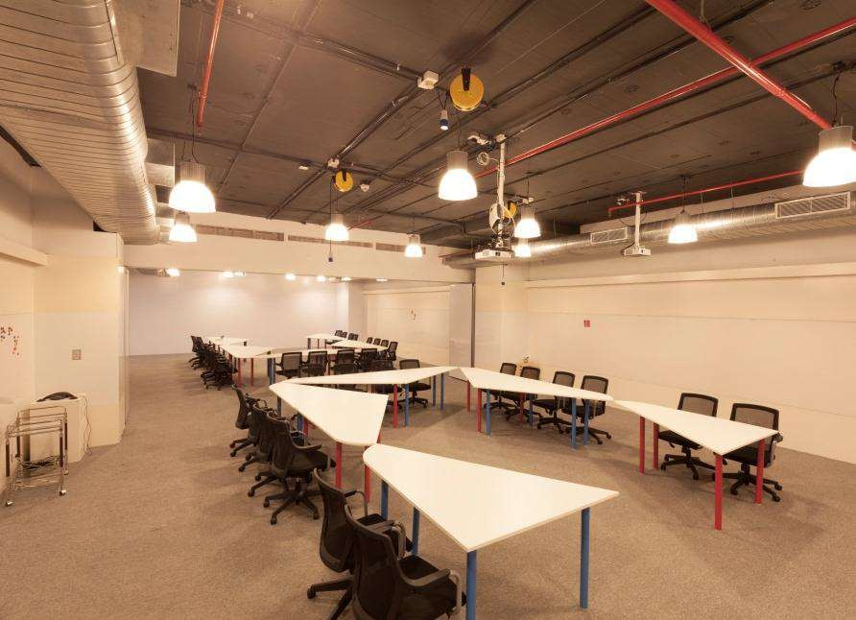
Collaborative discussions through Workshop Rooms – Writable Walls (CO1)

Slide 91
working on 1- hour Design problem(CO1)
A Design Challenge is a way for employers to assess how well you approach design problems and is often a good way to put your skills to the test.
STEPS
Start by taking a first stab at writing your design challenge down. It should be short and easy to remember. Try composing a single sentence that conveys the problem you want to solve. We often phrase these as How Might We questions to set our teams up to be solution-oriented and to generate a lot of ideas along the way.
Now that you have a draft of your design challenge, explore and align on the goal or outcome you hope to achieve. Use the Align on your Impact Goals activity to ensure that you, your team and any other stakeholders have the same vision of success in mind.

Slide 92
working on 1- hour Design problem Cont…(CO1)
Next you’ll want to think about the audience you’re aiming to serve and the context, constraints, and influences in their lives. Use the Define your Audience activity to map the ecosystem around your user and the shifts or changes that you might need to influence through your design. This step will help you see how broad or narrow your challenge scope needs to be.
Now that you’ve gathered and organized more information, review your design question and see if it still feels right. Refine your question and capture this, and the information you used to get there, in your Frame Your Design Challenge worksheet.
Framing the right design challenge is key to arriving at a good solution. A quick test we often run on a design challenge is to see if we can come up with five possible solutions in just a few minutes. If so, you’re likely on the right track. Try this, and make tweaks as needed to get to the right framing and scope.

Slide 93
Applying RCA (CO1)
Root cause analysis (RCA) is a method of problem solving used for identifying the root causes of faults or problems.
Steps to Apply the 5 Whys Tool
Step 1: Define the Problem
Step 2: Ask the Why questions
Step 3: Discussing the results

Slide 94
Brainstorming (CO1)
Brainstorming is a great way to come with a plenty of ideas that you would not be able to generate by just sitting down with a pen and paper.
The intention of brainstorming is to leverage the collective thinking of the group by engaging with each other, listening and building on other ideas.
Brainstorming can be used throughout the Design Thinking process to come up with a Design Solution.
Brainstorming comes in handy when you need to come up with ideas.
But have you ever been in one of those brainstorms where you ended up feeling totally blank or, even worse, more confused?

Slide 95
Effective Brainstorming (CO1)
Can be done for a well-defined problem or issue.
Also can be done for a problem/issue that has several possible solutions.
Can happen only with few constraints.
Comes to play when there is a need to generate ideas.
Happens best in reasonably larger groups.

Slide 96
Brainstorming: Do’s (CO1)
1. APPOINT A FACILITATOR
During a brainstorm, there should be someone to lead the group.
It doesn’t have to be the same person as the decision maker, but it should be the one who is able to guide through each topic or agenda as well as build up a positive atmosphere in the room.
The facilitator should also be the one who knows skills and expertise of people in the room, so that he/she could make the best out of everyone’s potential.

Slide 97
Brainstorming: Do’s (CO1)
2. BUILD ON EACH OTHER’S IDEA
What’s expected from a brainstorm is ideas. Many of them.
But rather than just throwing one idea after another, try breaking them down or building them up so that you can see where they’re linked together, and it helps you to see a bigger picture as well.
Moreover, by breaking down or building up ideas, everyone has a chance to participate and witness the evolution of that idea together.
3. WRITE AND DRAW
Visualizing ideas help different interpretations come to light and spark conversation.
Display them by writing down or drawing them in one place where everyone can see, so that they can feel involved as a contributor and no idea gets lost during the process.

Slide 98
Brainstorming: Dont’s (CO1)
1. FORCE PARTICIPATION
Force participation, like assigning participants with a turn to speak, will not help generating ideas but add social pressure to the group and kill the organic flow of a conversation instead.
2. CRITICIZE OTHER PEOPLE’S IDEAS
A brainstorm should be focusing on generating ideas rather than criticizing them.
Avoid making comments on other people’s opinions as stupid or useless. It’ll destroy the atmosphere of collaboration and intimidate others, making them afraid of sharing their ideas.
HOLD THE SESSION IN THE EVENING
A lot of people may overlook this point, but it’s very important when the brainstorming session is happening.
Try to avoid holding the session in the evening, especially at the time close to the end of business hours, since people could be distracted by their plans after work and be unable to focus.

Slide 99
Applying RCA and Brainstorm on innovative solutions (CO1)
The Department of science and technology within the government of INDIA has developed the INDIA INNOVATION INITIATIVE (i3) to create an innovation network, encouraging and promoting innovators and commercialization across the country.
The global innovation index aims to capture the multi dimensional facets of innovation and provide the tools that can assists in tailoring policies or promote long term output growth, improved productivity, and job growth.

Slide 100
Main project allocation and expectations from the project (CO1)

Slide 101
Expectations from the project (CO1)
To make the student understand areas of life that are important, the roles they play in their life.
After completing it is time to plan the actions needed to work on regaining balance in the student’s life.
Then the students have to Start with the neglected areas, what things they require to start doing to regain balance?
In the areas that currently sap energy and time, student can stop doing or reprioritize or delegate to someone else.
They have to make a commitment to these actions by writing them in the worksheet.

Slide 102
Weekly Assignment
Discuss practical application of design thinking tools and concepts.
Explain case study on McDonald’s Milkshake.
Illustrate Amazon India’s Rural Ecommerce.
Summarize case study on Gillette.
What does it mean working on 1- hour Design problem.
How we can apply RCA.
Brainstorm on innovative solutions.

Slide 103
Daily Quiz
Use the ________ tool to assess your level of satisfaction or creative fulfillment in each area of your life.
wheel of life assessment
RCA
Brainstorming
None of the above
_________ is a method of problem solving used for identifying the root causes of faults or problems.
Root cause analysis
LD0
Golden Circle
None of the above

Slide 104
Glossary Question
Brainstorming, Design Challenge, Discovery, Empathize
_______ is a first step of Design thinking Process in IDEO approach
_______ is the first step in the Design Thinking Process.
_______ is a great way to come with a plenty of ideas that you would not be able to generate by just sitting down with a pen and paper.
_______ is a way for employers to assess how well you approach design problems and is often a good way to put your skills to the test.

Slide 105
Expected Questions for University Exam
Discuss Design thinking & Innovation.
Define Design Thinking Mindset and Principles related to it.
Illustrate 5-Step Process of Design Thinking.
Summarize Design Approaches examples.
Explain Simon Sinek’s – Start with Why.
Elaborate the concept of The Golden Circle.
Analyse Root cause analysis.
Discuss “The Higher Purpose”.
Explain LDO.

Slide 106
Expected Questions for University Exam
Explain Visualization and it’s importance in design thinking,
Discuss reflections on wheel of life.
Linking it with Balancing Priorities.
Discuss the case study of DBS Singapore and Bank of Americas’ Keep the Change Campaign.
Memorize Litter of Light & Arvind Eye Care.
What do you understand by practical application of design thinking tools?
Describe the case study on McDonald’s Milkshake.
Explain the case study on Amazon India’s Rural Ecommerce
Discuss Gillette case study.
Summarize working on 1- hour Design problem,
How we can Applying RCA?
How to Brainstorm for innovative solutions?

Slide 107
Summary
Visualization and it’s importance in design thinking,
Reflections on wheel of life.
Linking it with Balancing Priorities.
DBS Singapore and Bank of Americas’ Keep the Change Campaign.
Litter of Light & Arvind Eye Care.
Practical application of design thinking tools.
McDonald’s Milkshake.
Amazon India’s Rural Ecommerce
Gillette.
Working on 1- hour Design problem
Applying RCA
Brainstorm for innovative solutions

Slide 108
References
Arun Jain, UnMukt : Science & Art of Design Thinking, 2020,Polaris
Jeanne Liedta, Andrew King and Kevin Benett , Solving Problems with Design Thinking – Ten Stories of What Works, 2013, Columbia Business School Publishing
Vijay Kumar, 101 Design Methods: A Structured Approach for Driving Innovation in Your Organization, 2013, John Wiley and Sons Inc, New Jersey
Pavan Soni, Design your Thinking : The Mindsets, Toolsets and Skill Sets for Creative Problem-Solving, 2020, Penguin Books

Slide 109
References
Thank You

